Slide 1

Pause
a stress free zone!
Hassan Sajid
Role: UX & UI designer and Usability testing
Duration - 10 weeks

Slide 2
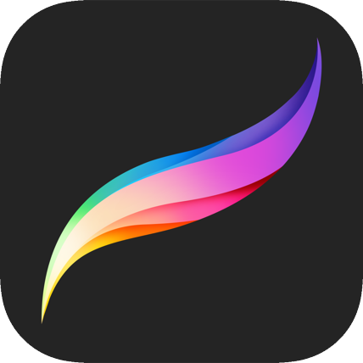
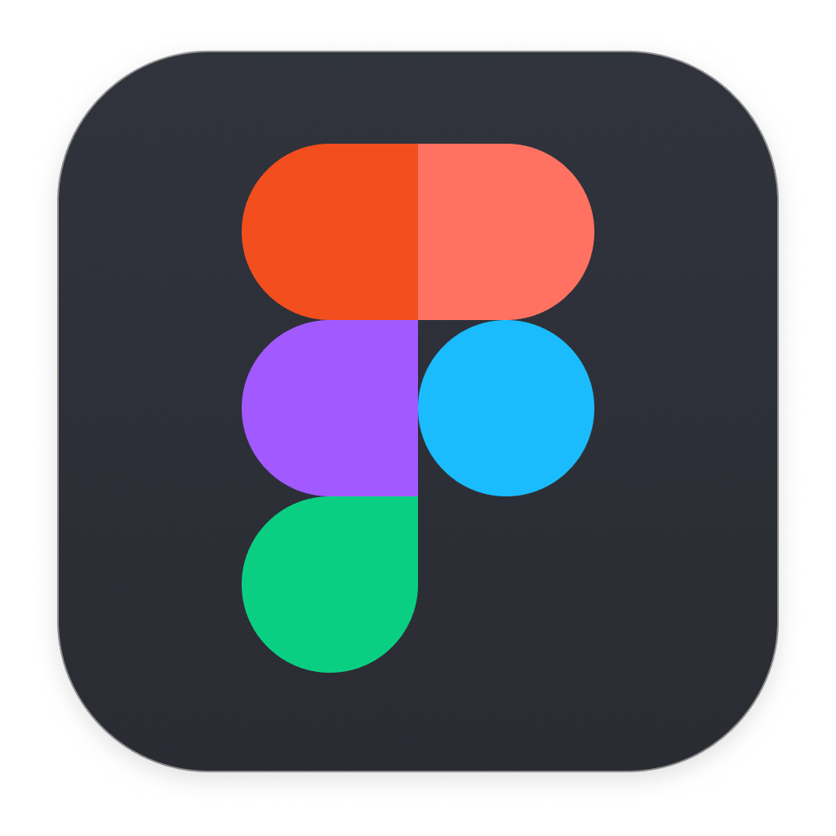



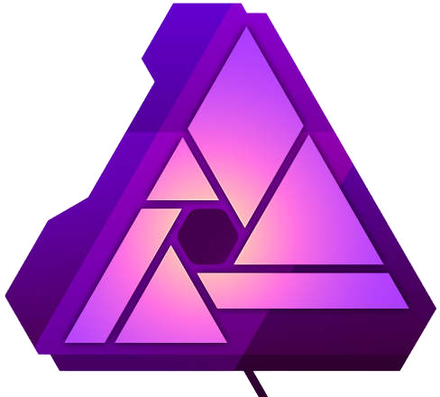

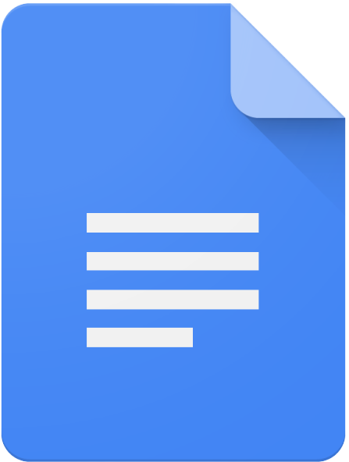
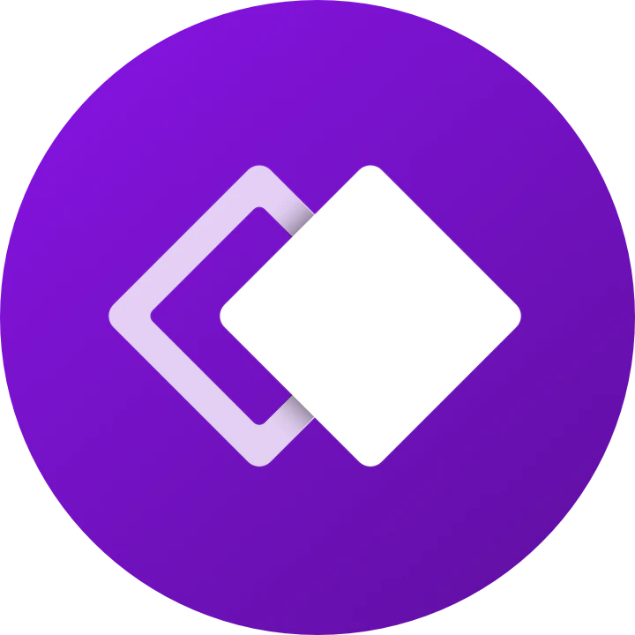
Tools used for the project:
Procreate
Figma
Miro
Zeplin
Lookback
Affinity Photo
Mobbin
Google Docs
Whimsical

Slide 3
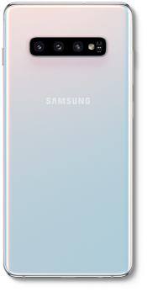
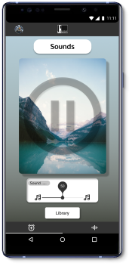
What is Pause? And why?
Pause is an Alarm clock and a Meditions app which which allows users to pick from sounds of nature as alarm tone of to be played in the background while they meditate or trying to relax.
Research has shown hash alarm tones can increase individuals blood pressure and can leave you feeling groggy.
Pause helps users stay on track while not adding to their existing stress level and the Sound section let’s users pick from library of sounds to be played for set amount of time (which they set) while they meditate or are trying to relax or if they want play something in background while they study or work, it really depends on users how and when they want to use the app.

Slide 4
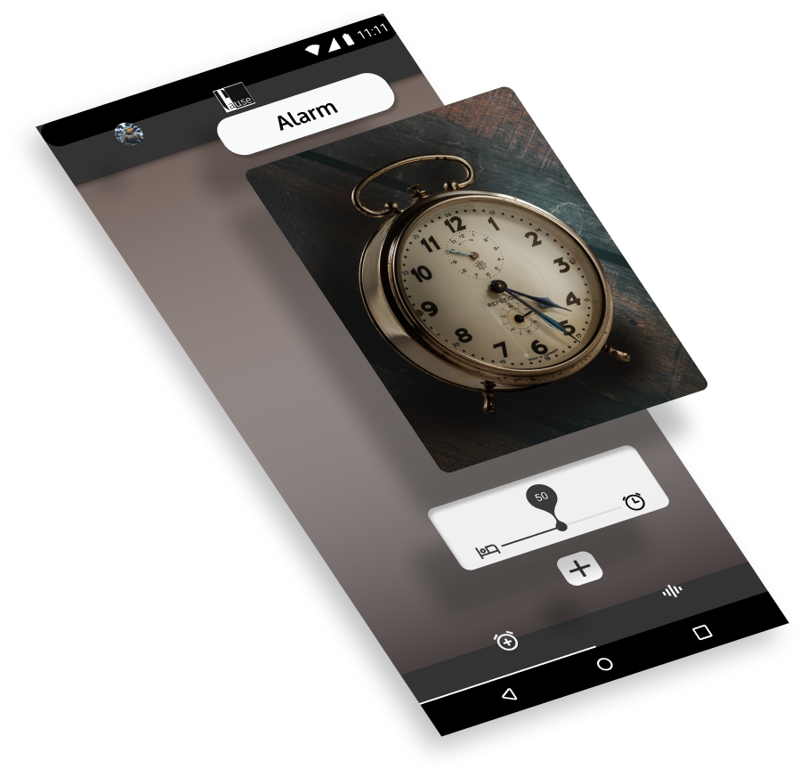
Goals
To make an app which allows users to set alarm and pick from the library of natural sounds to be used as wake up tune. The app should give user information if alarm is set and time till alarm goes off.
The app should allow user to play from the same library of sounds, background music while they meditate or are trying to relax. The user should be able to set length to time the background music is played for and stop after.

Slide 5
Problems & Solutions
Problems & Solutions
Problems
Solutions
Research shows that waking up to harsh alarm tone does have impact on one’s health and stress level.
Alarm app in the phones don’t allow users to add more tones or change the intensity.
Use apps like YouTube to play background music can have have huge impact on users device’s battery life and can use up a lot of users data allowance.
Alarm app which allows users to pick from sounds. Theses sounds are to be played softly and help user wake up slowly.
User will have ability to request new sounds to be added and new sounds can be added based off of popular demand.
Having an ability to download Sounds over WiFi, with an ability to be played for set length of time and with screen turned off to save battery.
01
01
02
02
03
03

Slide 6
“I don‘t believe in taking the Right decision, I take decision and make it Right”
Muhammad Ali Jinnah

Slide 7
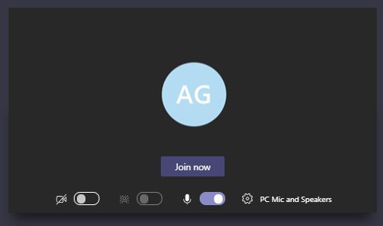
Discovery Research
To kick start my research I sent an email arounds my office (about 120 individuals) inviting them to take part and picked 5 out of those who replied.
When picking I choose individuals belong to different age groups, this helped when designing to keep users from different age group in mind. Interviews were conducted via Microsoft teams.
Findings from this helped me create a survey for wider audience which allowed me to test some hypothesis and identify user patterns.

Slide 8
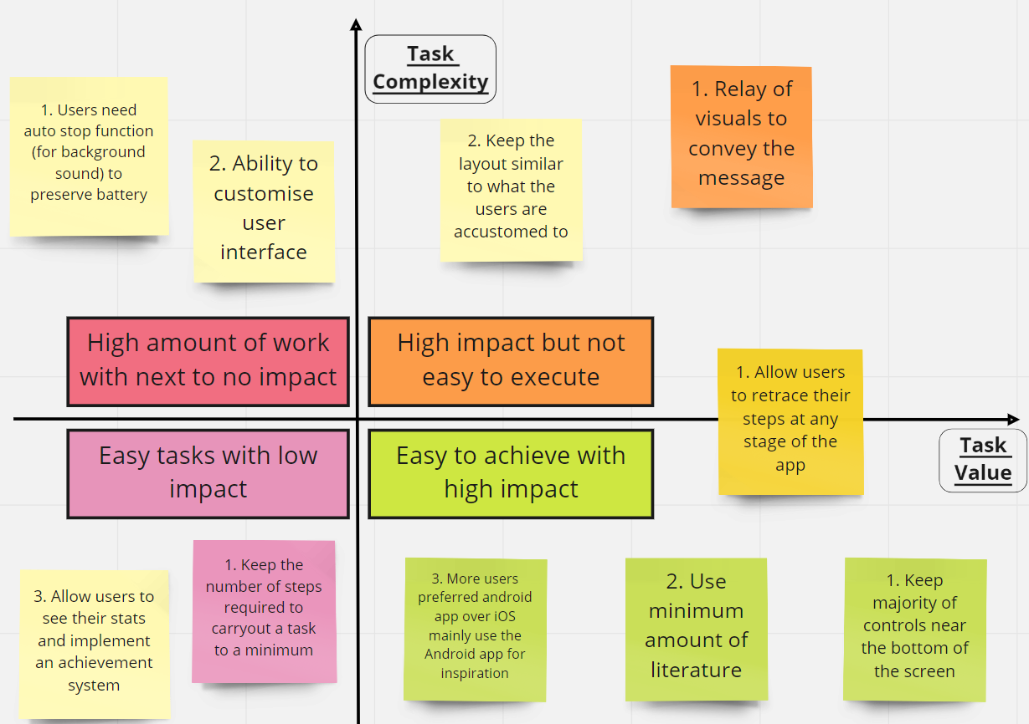
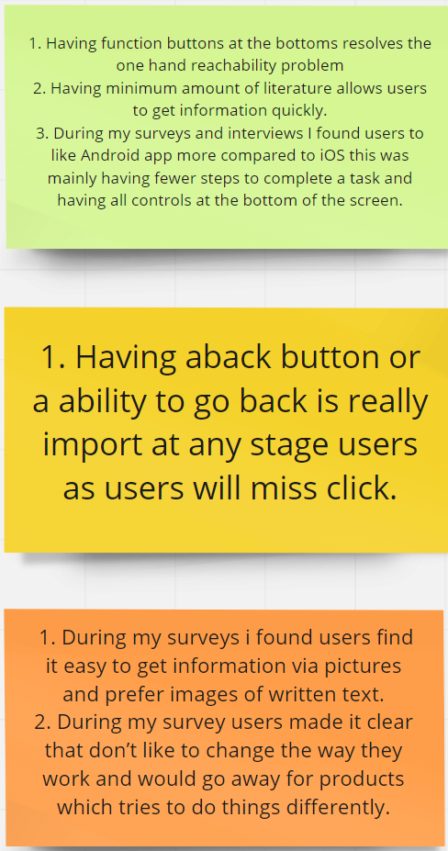
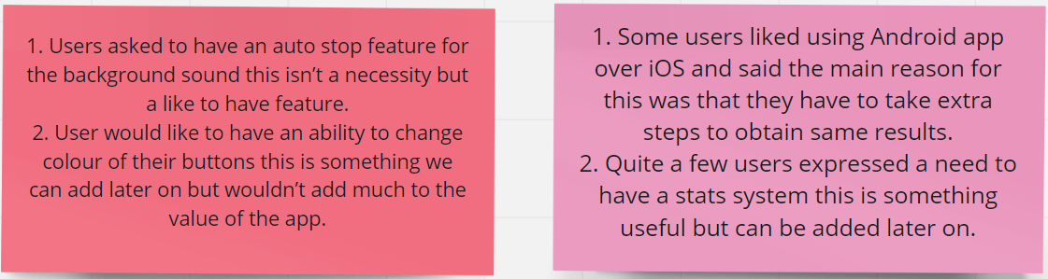
Research Analysis
Data collected allowed me to create Affinity diagram on Miro.
Miro is allowed me to create digital white board and which I used to group my findings and prioritise work via Value vs Complexity graph.

Slide 9
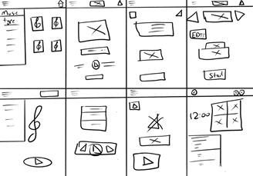
Design sketching and prototyping
Using Crazy-8 technique I made some quite sketches on Pro-create. This helped in quickly visualise my thoughts and refine them into something i can work towards.
After getting my quick sketches cleaned up I moved to Figma where I made user flow, wireframes, low-fidelity and finally high-fidelity prototypes.
During this time I used Mobbin see other apps in the market for inspiration.

Slide 10
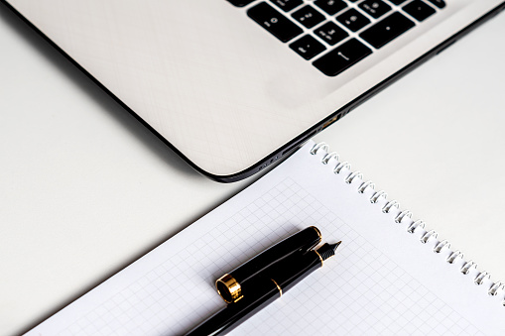
Prototype testing & iteration
Testing something which shouldn’t be taken lightly.
To make sure my prototype functions as intended for the wider audience testing, I ran several tests myself and invited users from my research interviews to test run the app in a live session via Microsoft teams.
During these tests I tried different colours palette, visual images, icons and fonts.

Slide 11
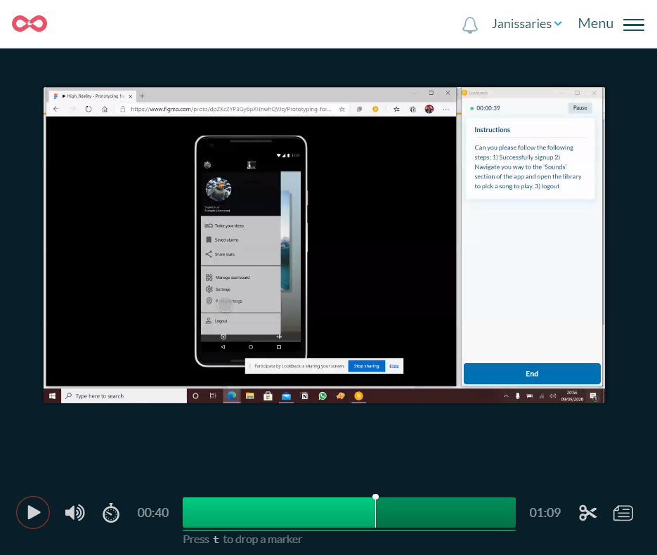
Wider audience testing & more iterations
Possibly the most exciting part. Using Lookback I sent my high-fidelity prototype to video audience to trial. After the initial three tests I reviewed their feedback and watched their progress. This helped me identify some improvement opportunities for accessibility and overall design. I then repeated the same process with next three and four after.
This than lead me to my final designs.
In the end I exported the designs to Zeplin to create a style guide for engineering handoff

Slide 12
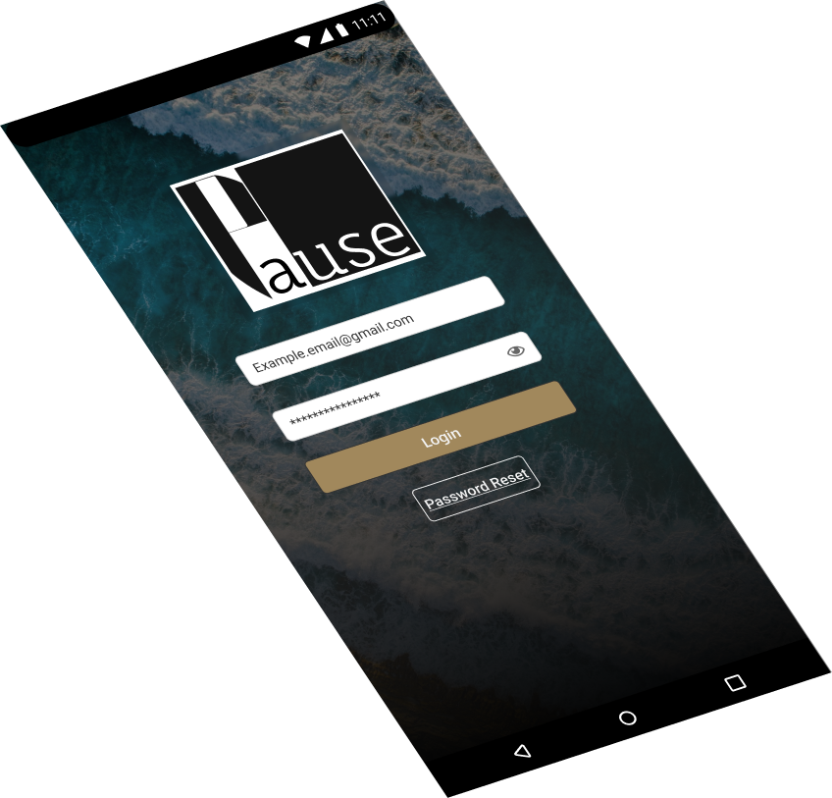
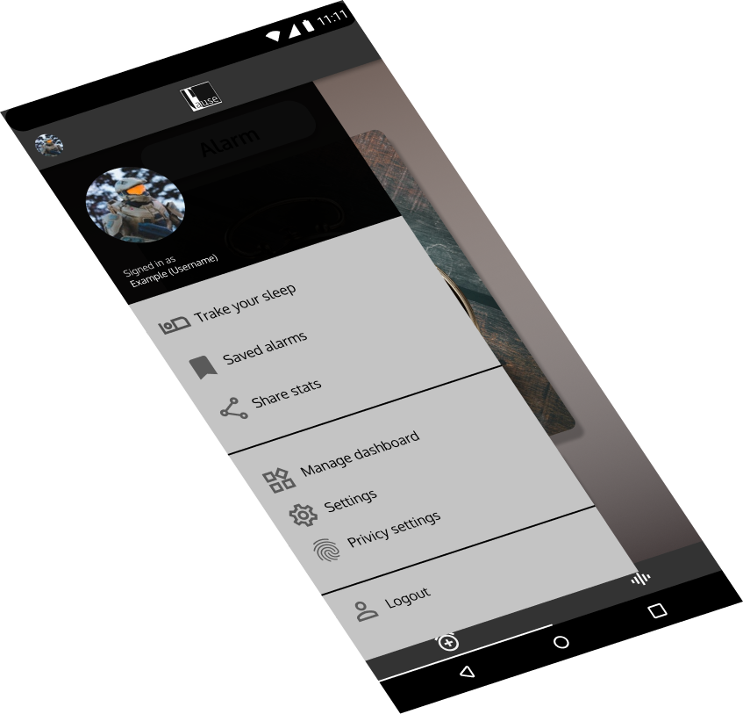
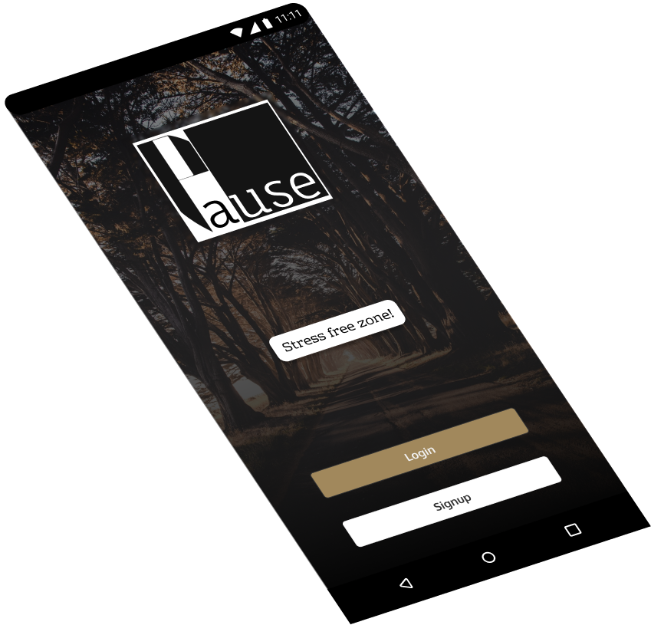
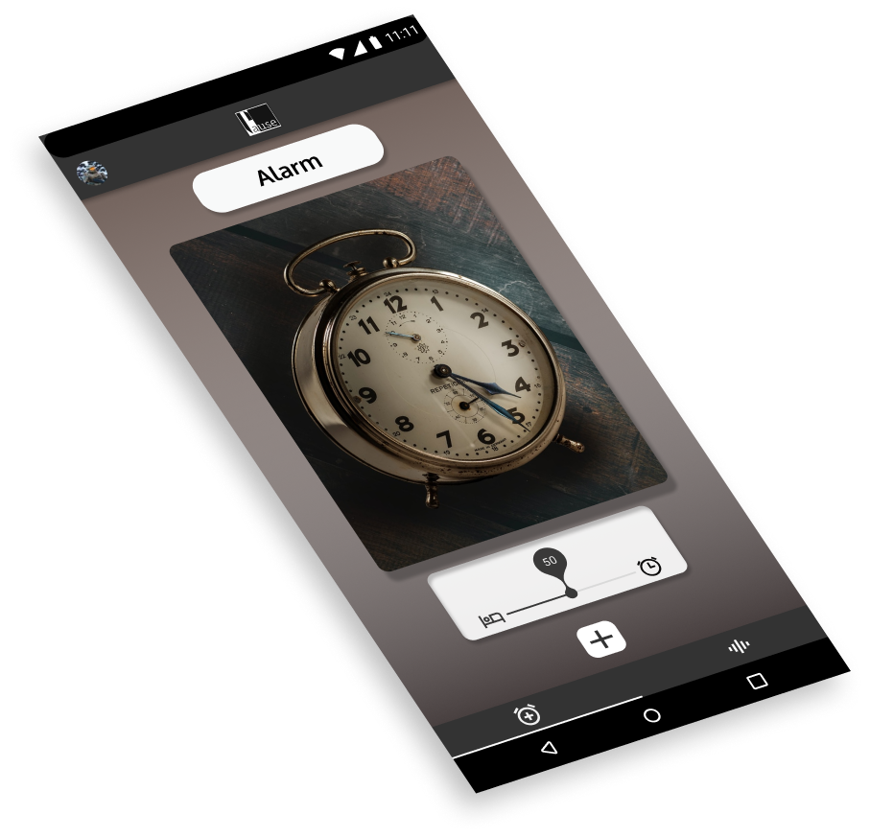
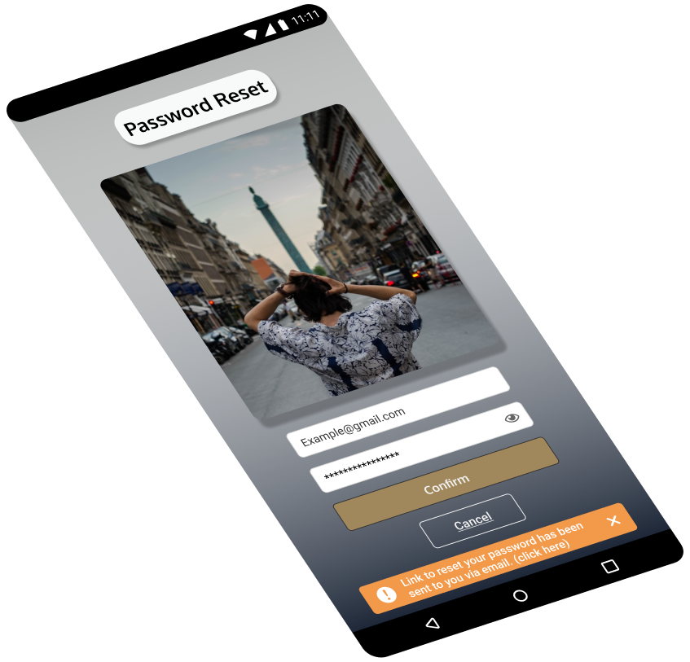
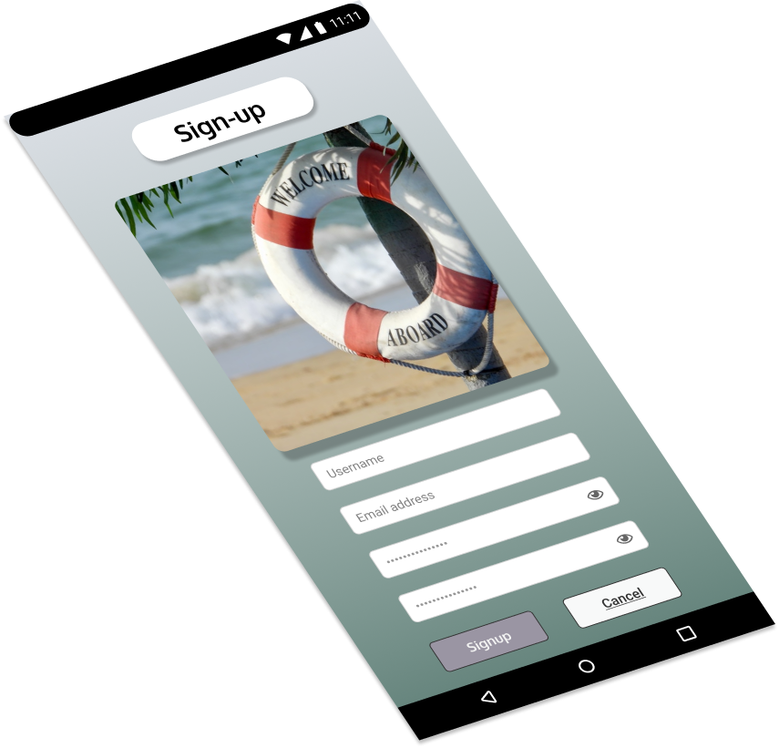
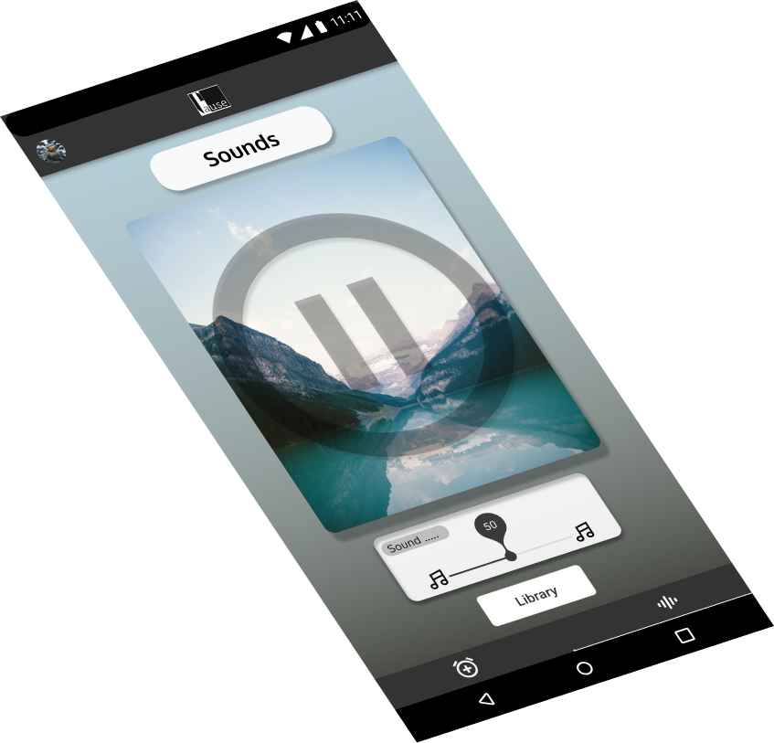
Clickable Figma prototype
https://www.figma.com/proto/dpZKcZYP3Oy6pXHnwhQVJq/Prototyping-for-Pause?node-id=113%3A15898&scaling=scale-down

Slide 13
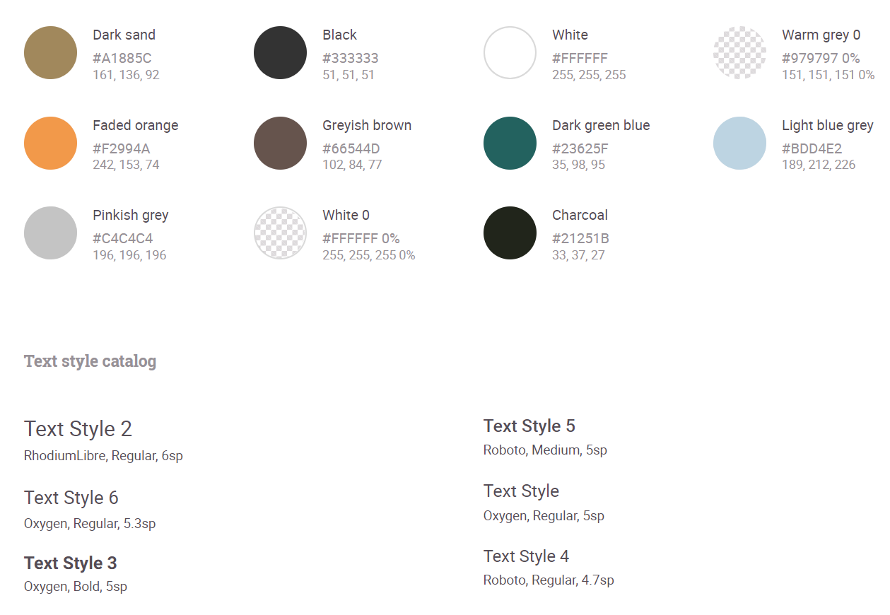
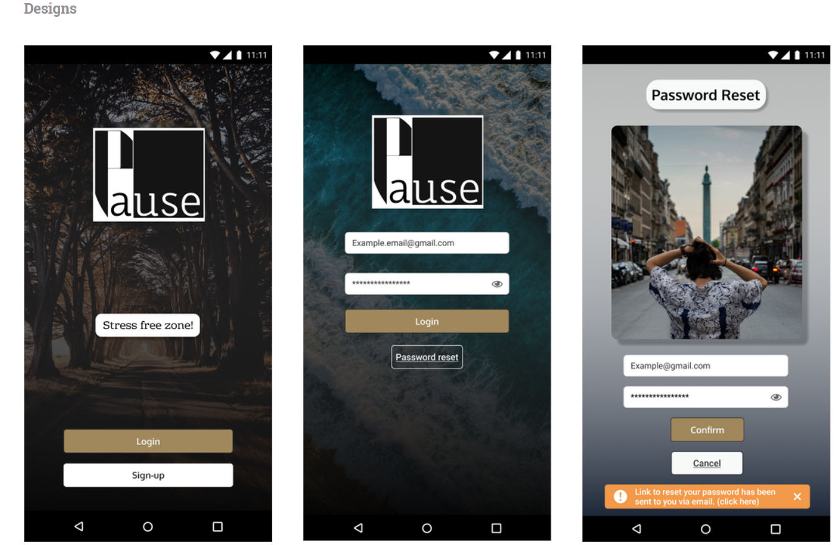
Style guide

Slide 14
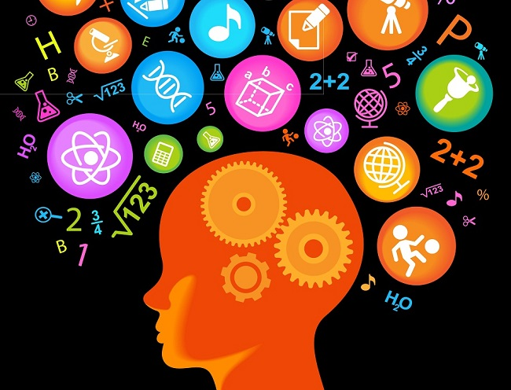
What I have learned?
Keep things simple!
What works for you might not work for everyone. We often when designing forget to to understand our users will probably not know as much about the product as we (the designer know) so keeping things simple and and finding a good balance between overcrowded screens and lacking screens is key.

Slide 15
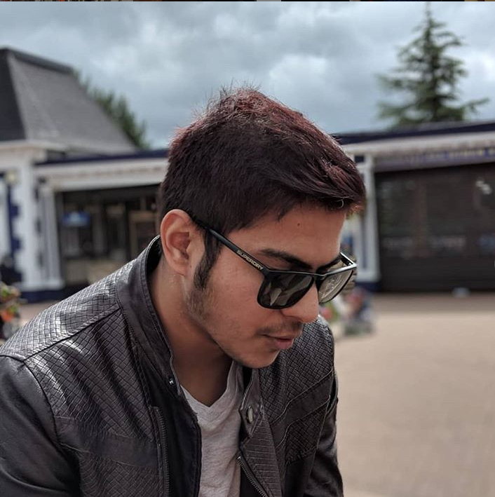
About me:
Passionate and eager to learn new and improve ways to work.
My name is Hassan Sajid I live in Stoke-On-Trent and work in HMRC Birmingham.
I am self motivated and always looking for opportunities to take my skill to the next level.
I did a Nano-degree in UX design with Udacity and have Maths and Product design A-levels.
I have been working in the HMRC for about 4 years and have worked on several internal projects which eventually pushed me to pursue a career in UX design.
I have great communication skills and fluent in 3 different languages which allow me understand the customer/user and provide the best service possible.

Slide 16


Thank you for your time
Got any questions or want to know more?
Get in touch via
hasn_90@yahoo.com
https://www.linkedin.com/in/hassan-sajid-216465174/

